Slide 1


Cyber Defense Organization
Spring 19’ - Threat Hunting (at scale)
Notes:
Roses are grey,
Violets are grey,
Our logo is grey,
Everything is grey,
I’m so lonely.
-[Redacted]

Slide 2
Agenda
Note: Last week was a pure lecture/do as I do. This week is 50/50.
Who are you?
Small Term of the week
What is a SIEM
Why Do I care?
Do as I do
Labs

Slide 3
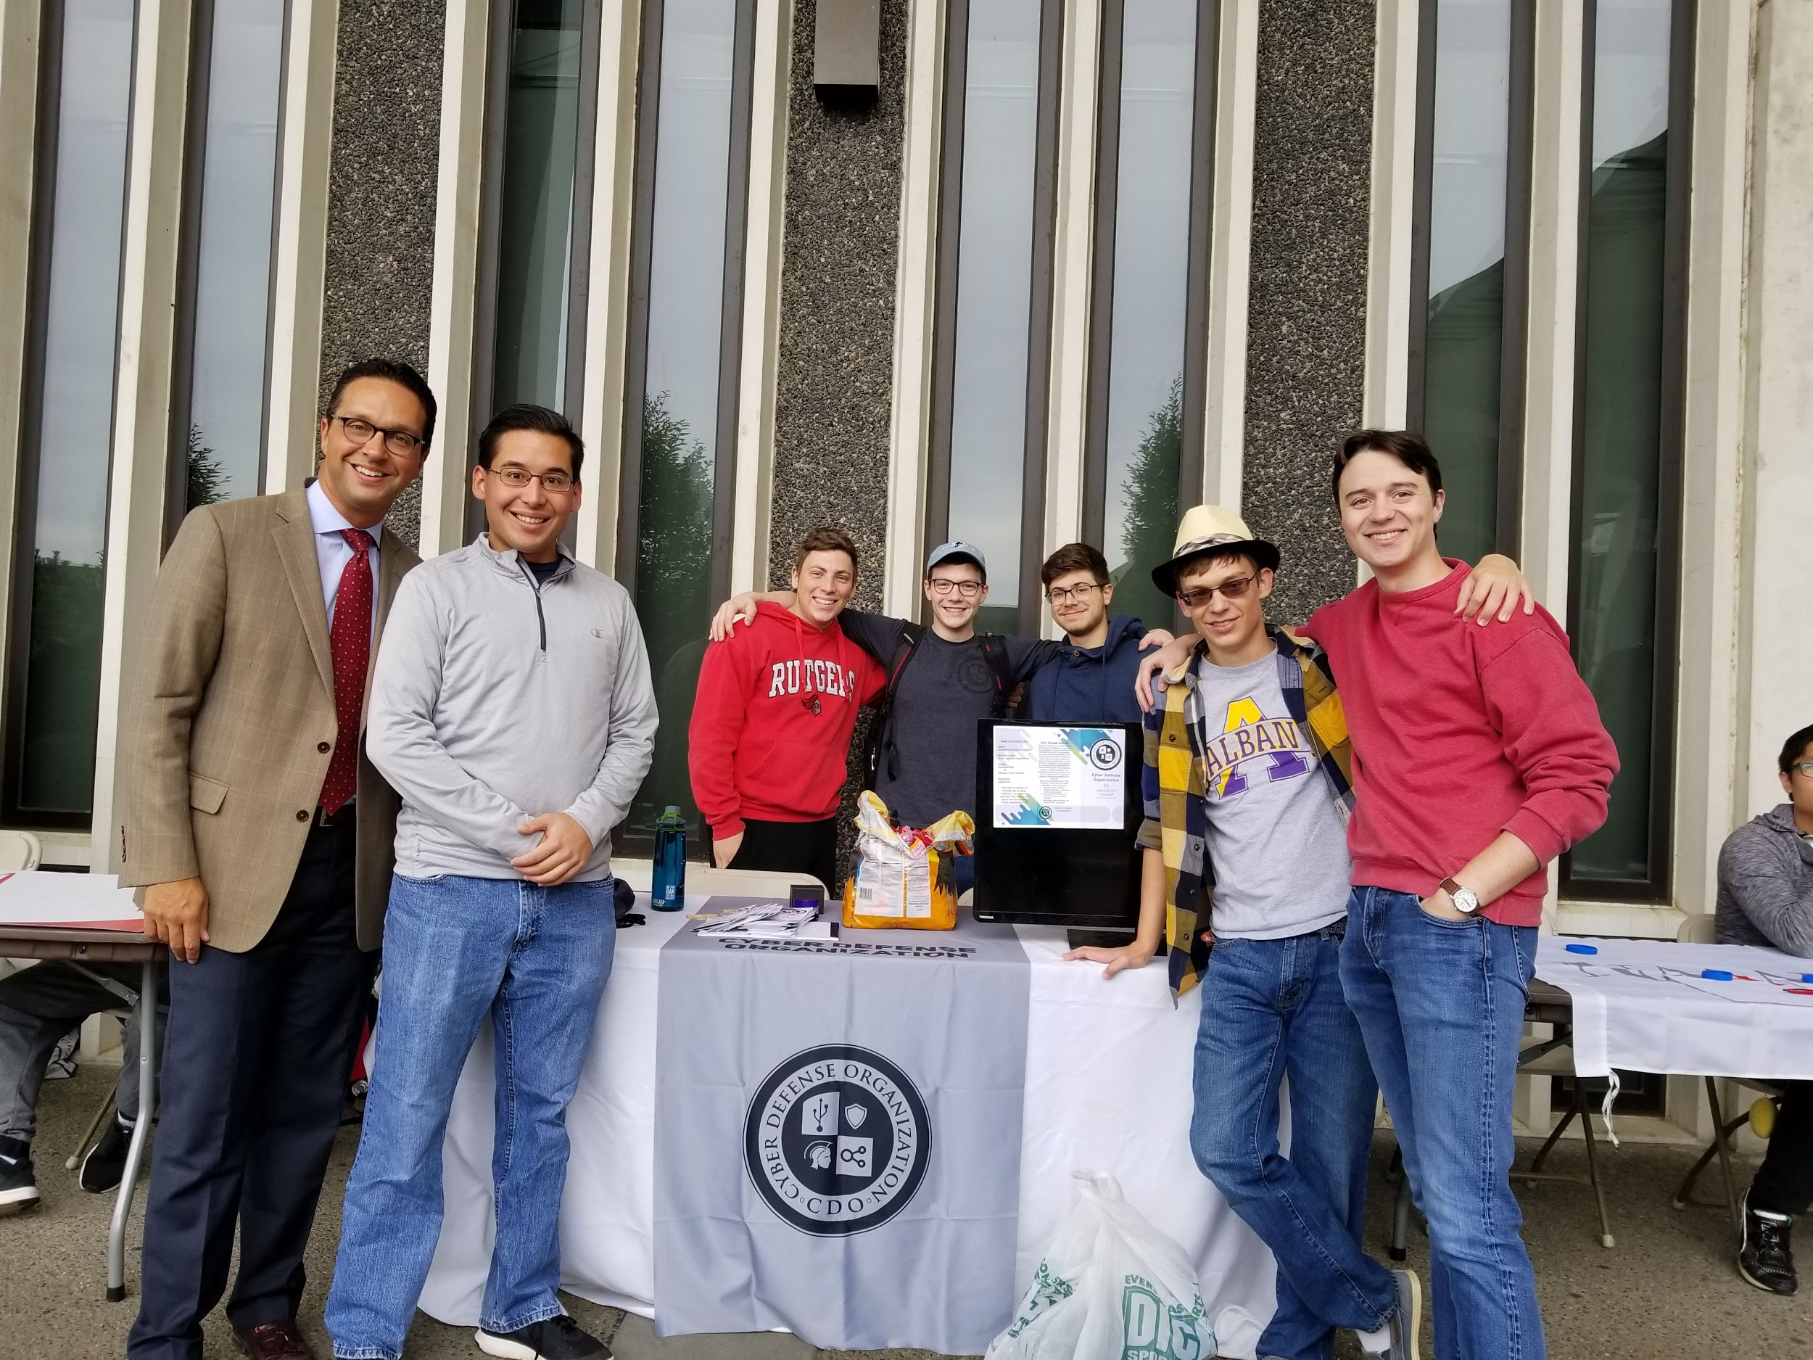
Who are you:
Liam Smith
President of CDO. Interned at the MLB and DMV. CCDC main windows guy. Got a CySA+.
Met Michael Christakis once.
Epic ‘shop skills.
Notes:
Redacted by [redacted]

Slide 4

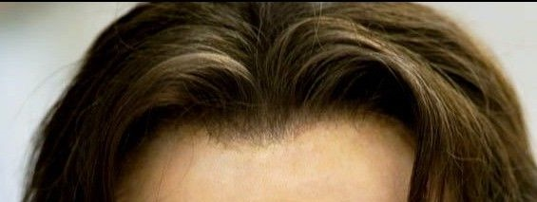

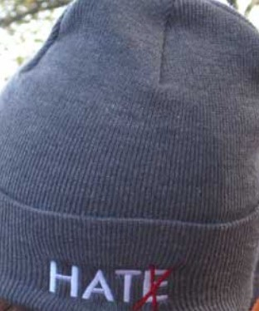

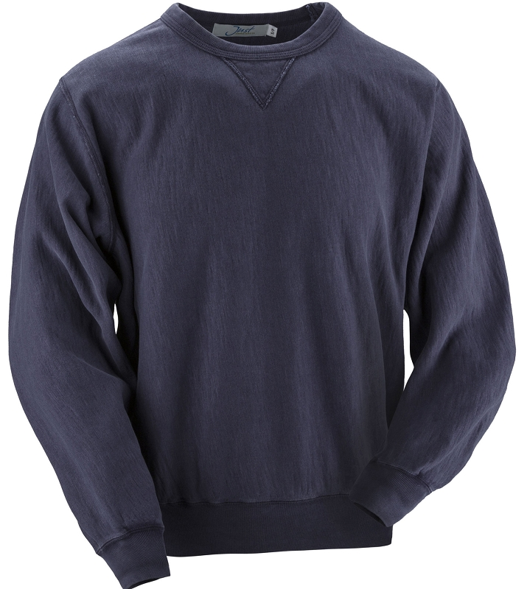
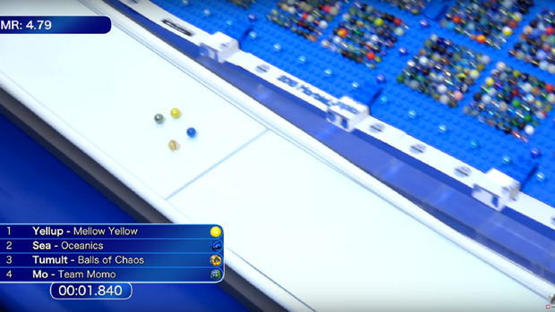
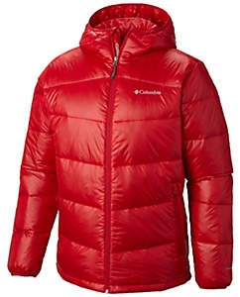


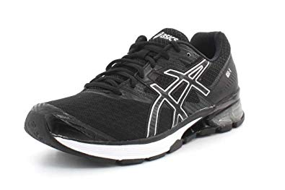


Liam Starter Pack
Me
Uncomfortable Person
“I’m literally dying”
“Hi literally dying I’m Liam”
Notes:
“I hate you all” (Smith, 2019)

Slide 5
Small Term of The Week
Pneumonoultramicroscopicsilicovolcanoconiosis: lung disease from inhaling volcanoes
Notes:
Supercalifragilisticexpialidocious,
Even though the sound of it is something quite atrocious;
If you say it loud enough, you’ll always sound precocious,
Supercalifragilisticexpialidocious!

Slide 6


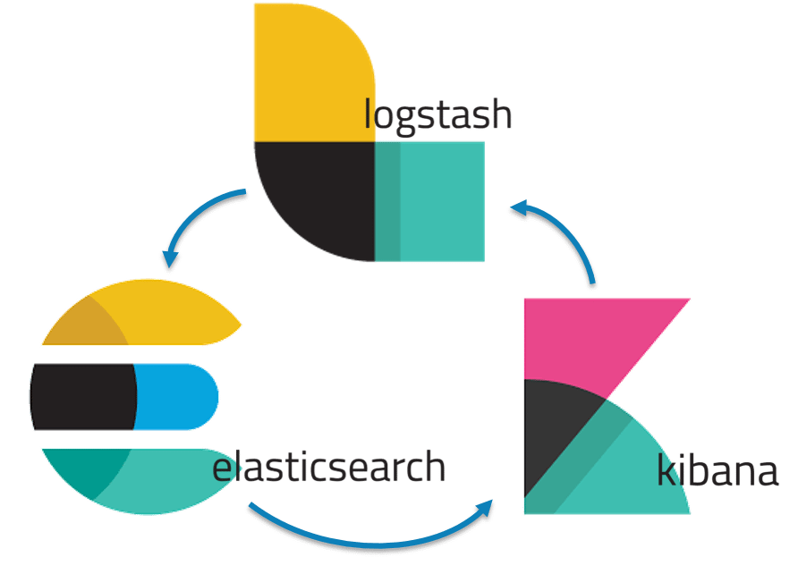
What is a SIEM?
Security information and event management (SIEM): The underlying principles of every SIEM system is to aggregate relevant data from multiple sources, identify deviations from the norm and take appropriate action.
TL;DR A big fanny database disguised as security software.

Slide 7
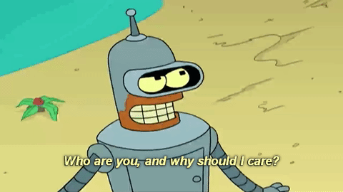
Why Should I Care?
Notes:
Because you’ll need this to form the Megazord.

Slide 8
Core Enterprise Security Stack
Security Tools:
Vulnerability Scanner
IPS/IDS
SIEM
Anti-Virus
DLP
System Administration:
Active Directory Group Policy
Firewall Rules
NetFlow
Patch Management
Policy:
Password
Acceptable Use
BYOB
Patching Schedule

Slide 9
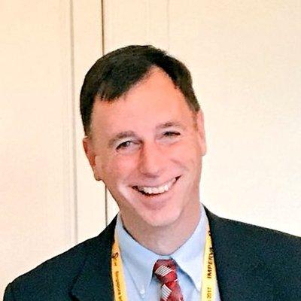
Rob Joyce said so.
“Enable those logs, but also look at those logs.
You’d be amazed at incident response teams goes and there's been some tremendous breach and yep there is it is, right there in the logs.”
https://youtu.be/bDJb8WOJYdA?t=1312
Notes:
This. This is the face of a man you can trust.

Slide 10
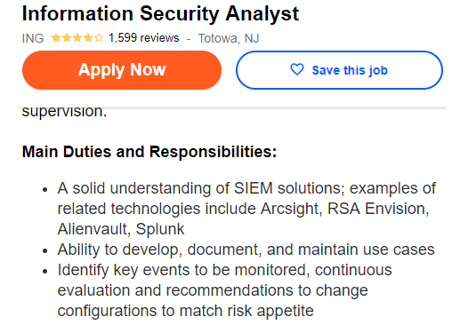

Finally: Jobs
These technologies are everywhere and it's a core skill for any InfoSec professional.
Also, if you are Interning, odds are it will be something you do.
Notes:
Who needs ‘em?

Slide 11
Plans for Today
We are going to be using a SIEM called SumoLogic.
Why?
Its a growing in popularity,
it has almost the same query language as Splunk,
and it has an open free training environment.
Notes:
*Late addition*: perform the ritual sacrifice

Slide 12
Getting On Sumologic
Goto:
Site: service.sumologic.com
User: training+labs@sumologic.com
Pass: Sum0Labs!
https://tinyurl.com/SumoCore
https://tinyurl.com/SumoSec

Slide 13
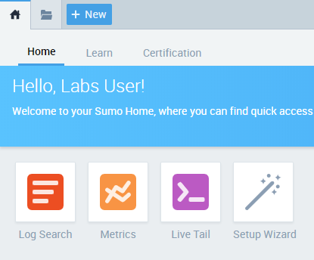
Basics - What Logs?
Select Log Search

Slide 14
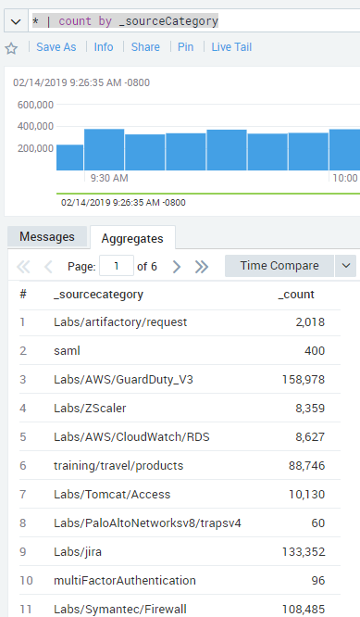
Your Very First Search
* | count by _sourceCategory
What does this do?

Slide 15
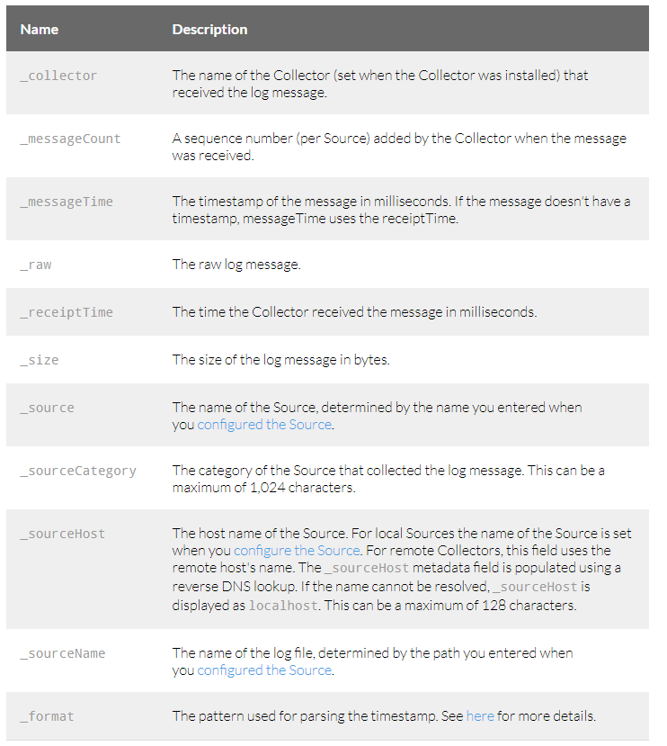
Sumologic Internals
All data/Logs that Sumologic ingests are tagged with metadata.
_sourceCategory ls the “bucket” or category the team wanted it to be in.
_collector is the name of the collector agent.
_sourceHost is the name of the host the log came from.

Slide 16
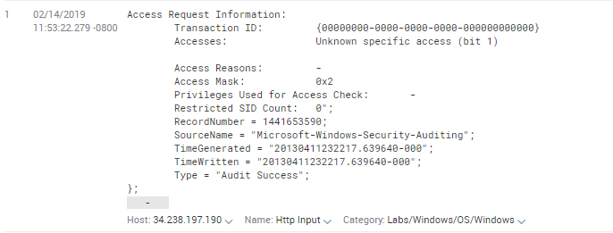
Parsing Logs
_sourceCategory=Labs/Windows/OS/Windows
What the hell is this...and how do I work with it?

Slide 17
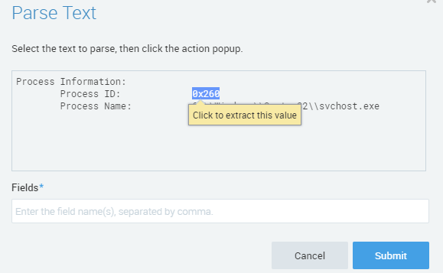
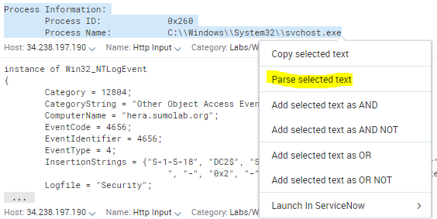
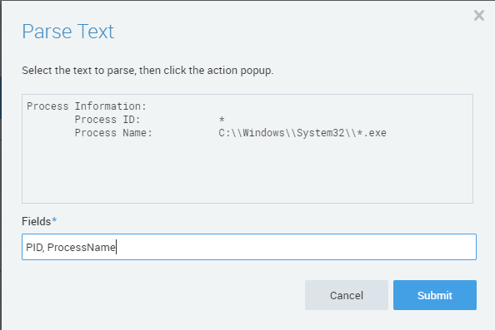
Parsing for Real
Find a Process Information Log
Highlight All of it, and select Parse.

Slide 18
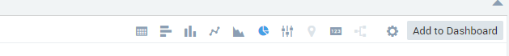
Query
_sourceCategory=Labs/Windows/OS/Windows
| parse "Process Information:\n\tProcess ID:\t\t*\n\tProcess Name:\t\tC:\\\\Windows\\\\System32\\\\*.exe" as ID,ProcessName
| count by ProcessName

Slide 19
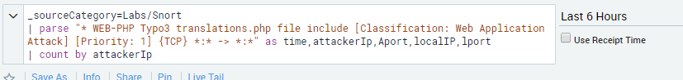
Finally: Snort
Snort is an IPS and we have some fun logs!
_sourceCategory=Labs/Snort
Parse the time, attackerIp, Attackerport, localIP, Lport
| count by attackerIp

Slide 20
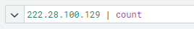
Investigate
Where can else can we see this IP?
When I made this, this IP was mention in the logs 2.7k times.

Slide 21
Last Thing: Outlier Analysis
_sourceCategory=Labs/Snort
| parse "* WEB-PHP Typo3 translations.php file include [Classification: Web Application Attack] [Priority: 1] {TCP} *:* -> *:*" as time,attackerIp,Aport,localIP,lport
| timeslice 5m
| count (attackerIp) as AIP by _timeslice
| outlier AIP window=5, consecutive=1, threshold=2, direction=+-

Slide 22
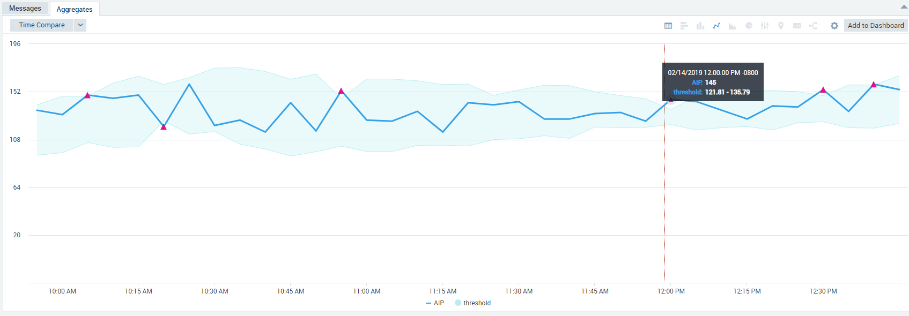
Pretty Right?

Slide 23
To Summarize
SIEMs are huge databases of important log data.
You can query them to find specific things, (IP addresses), trends (attacks over time) and so much more.

Slide 24

Lab Time!
If you want to get a good foundation in querying:
https://tinyurl.com/SumoCore
If you have a good grasp of SQL/Querying and/or are only here to look at security suff:
https://tinyurl.com/SumoSec

Slide 25
Announcements
Working on an interesting project? Have a specialty? Present
If you are interested in a topic/want to present email us!
cyberdefenseorg@albany.edu

Slide 26
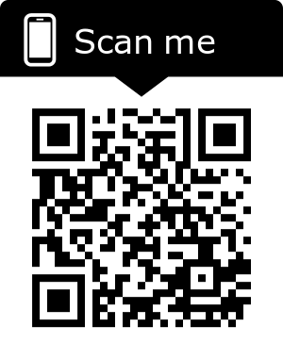
J-Board Applications!
OPEN POSITIONS:
Treasurer
IT-Chief Technology Officer
Competition Captain
Competition Co-Captain
EVERYONE SHOULD APPLY (:

Slide 27


Certification Study Group - Security +
Tuesday nights at 7:15 in bb123.
Study as a group
Talk to Mark

Slide 28
Other Updates!
“Our second Cyber Jobs Fair is scheduled for March 6, 2019.
10:00 – 12:00: Company Pitches (Location: TBA)
Pizza will be available for students around 11:30
12:00 – 3:00: Student Interaction with Employers / Business Building Living Room
Please fill out the Doodle Poll to RSVP for the Cyber Jobs Week by Tuesday 2/22. By RSVPing you are enabling us to create your name tags and order a sufficient amount of food. The final list of attendees will be compiled on 2/24.”
Cyber Jobs week is coming up:
RSVP: https://doodle.com/poll/7crgg264hbkgzdy8
Send Resumes in for critique.

Slide 29

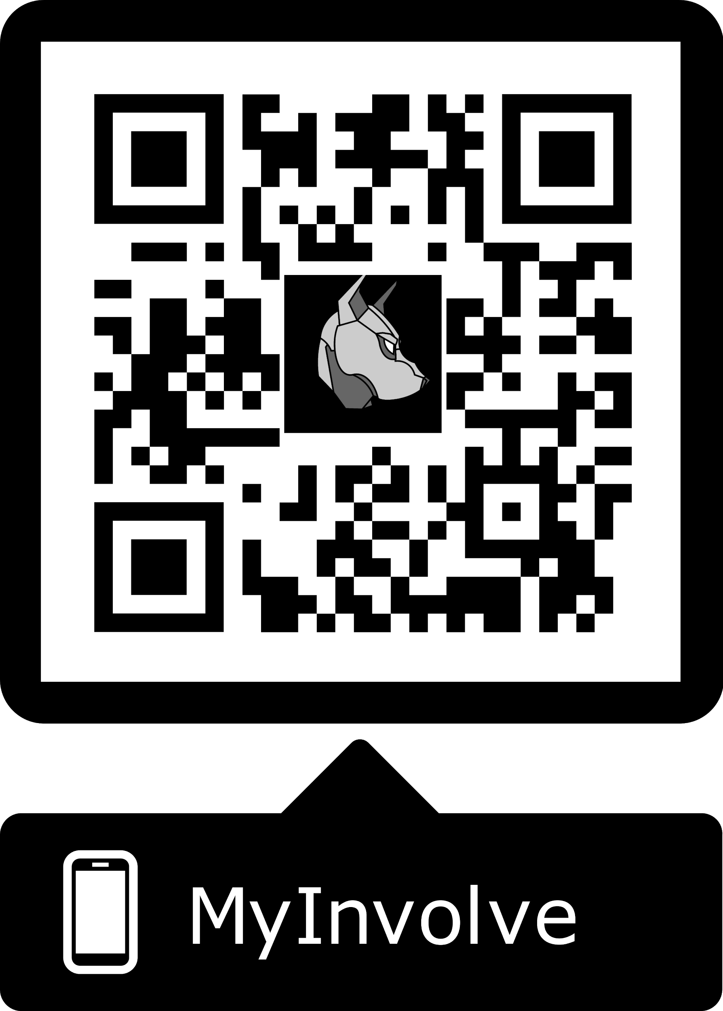
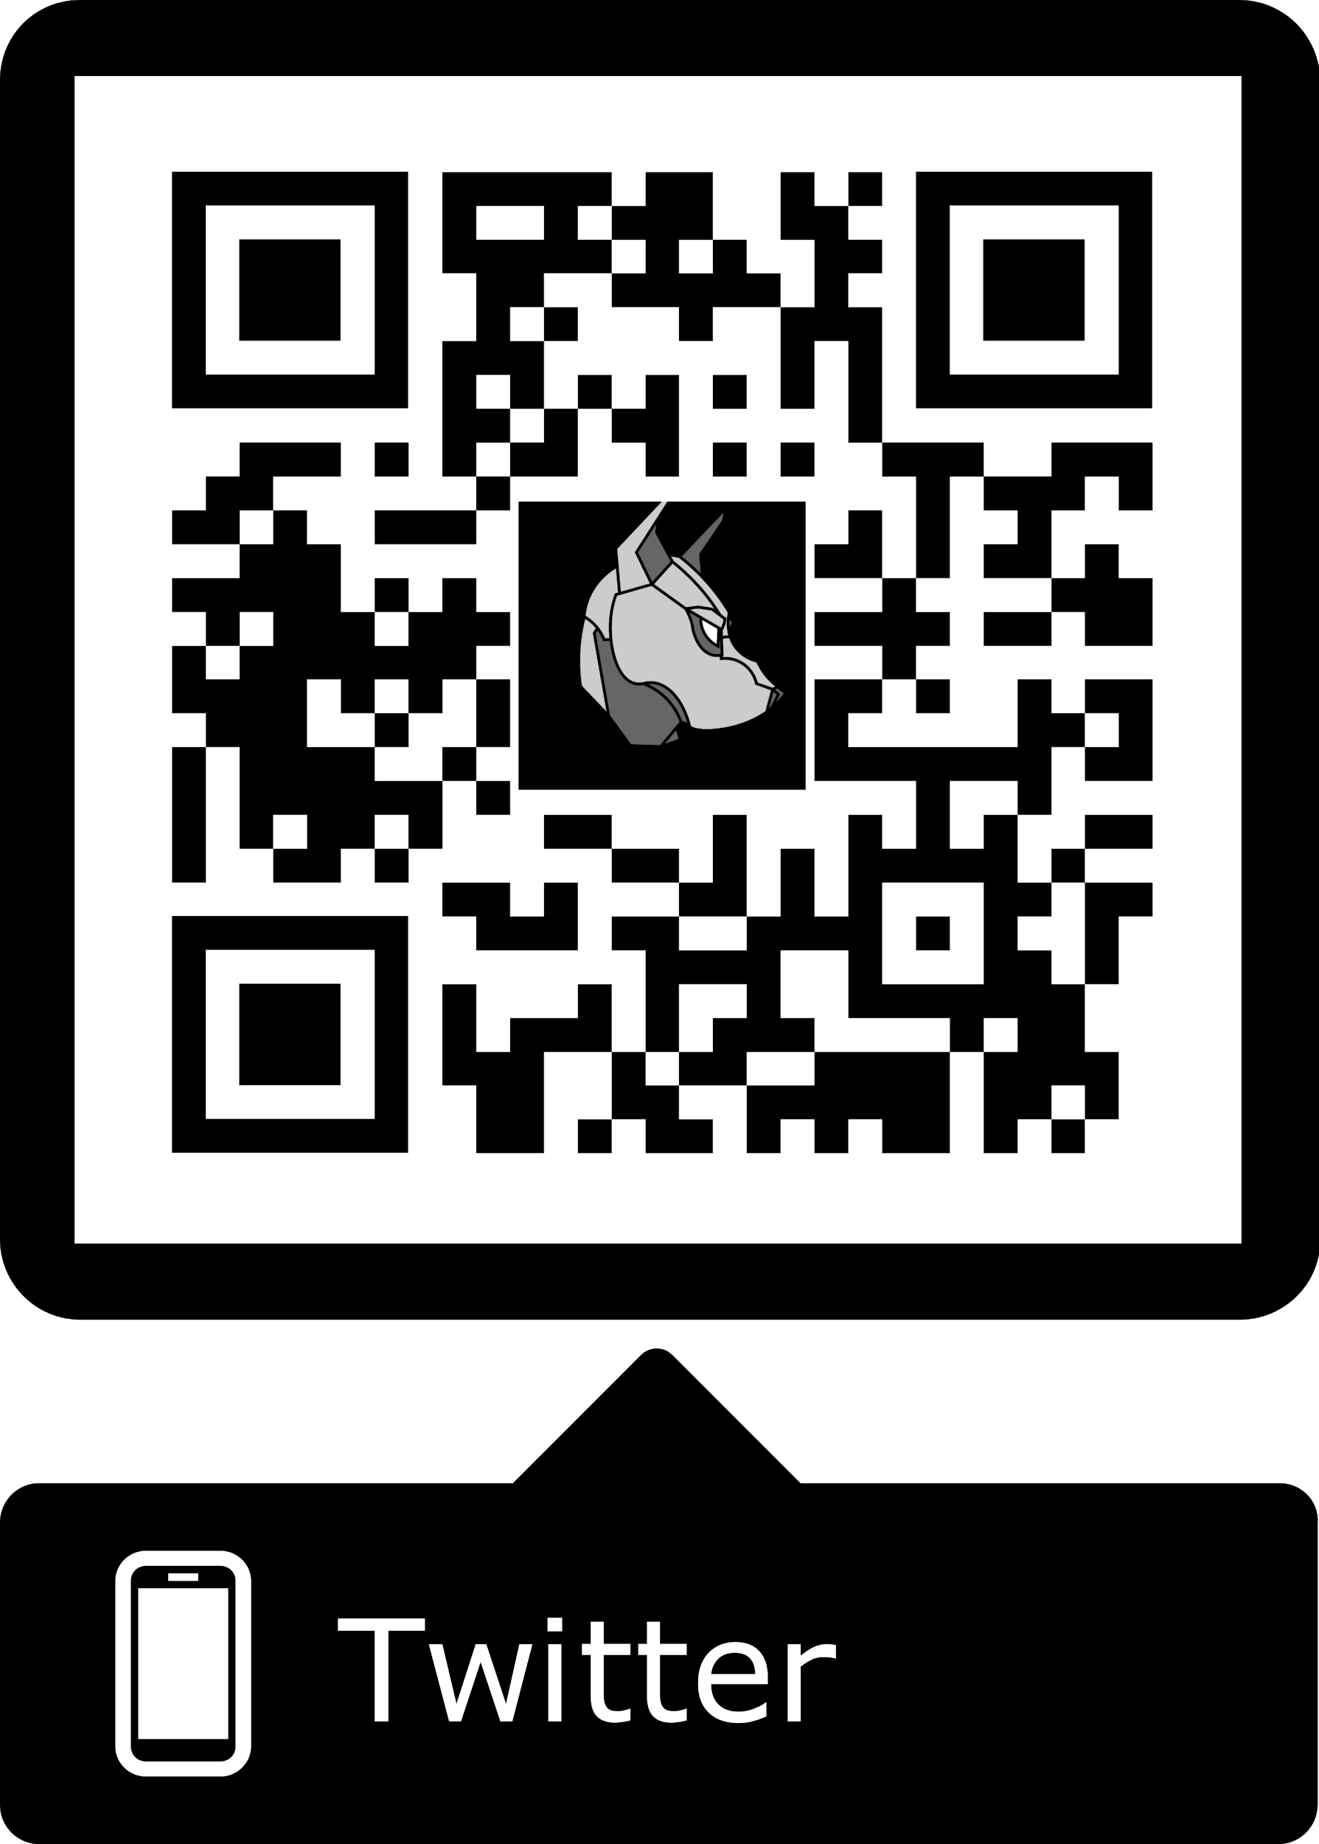
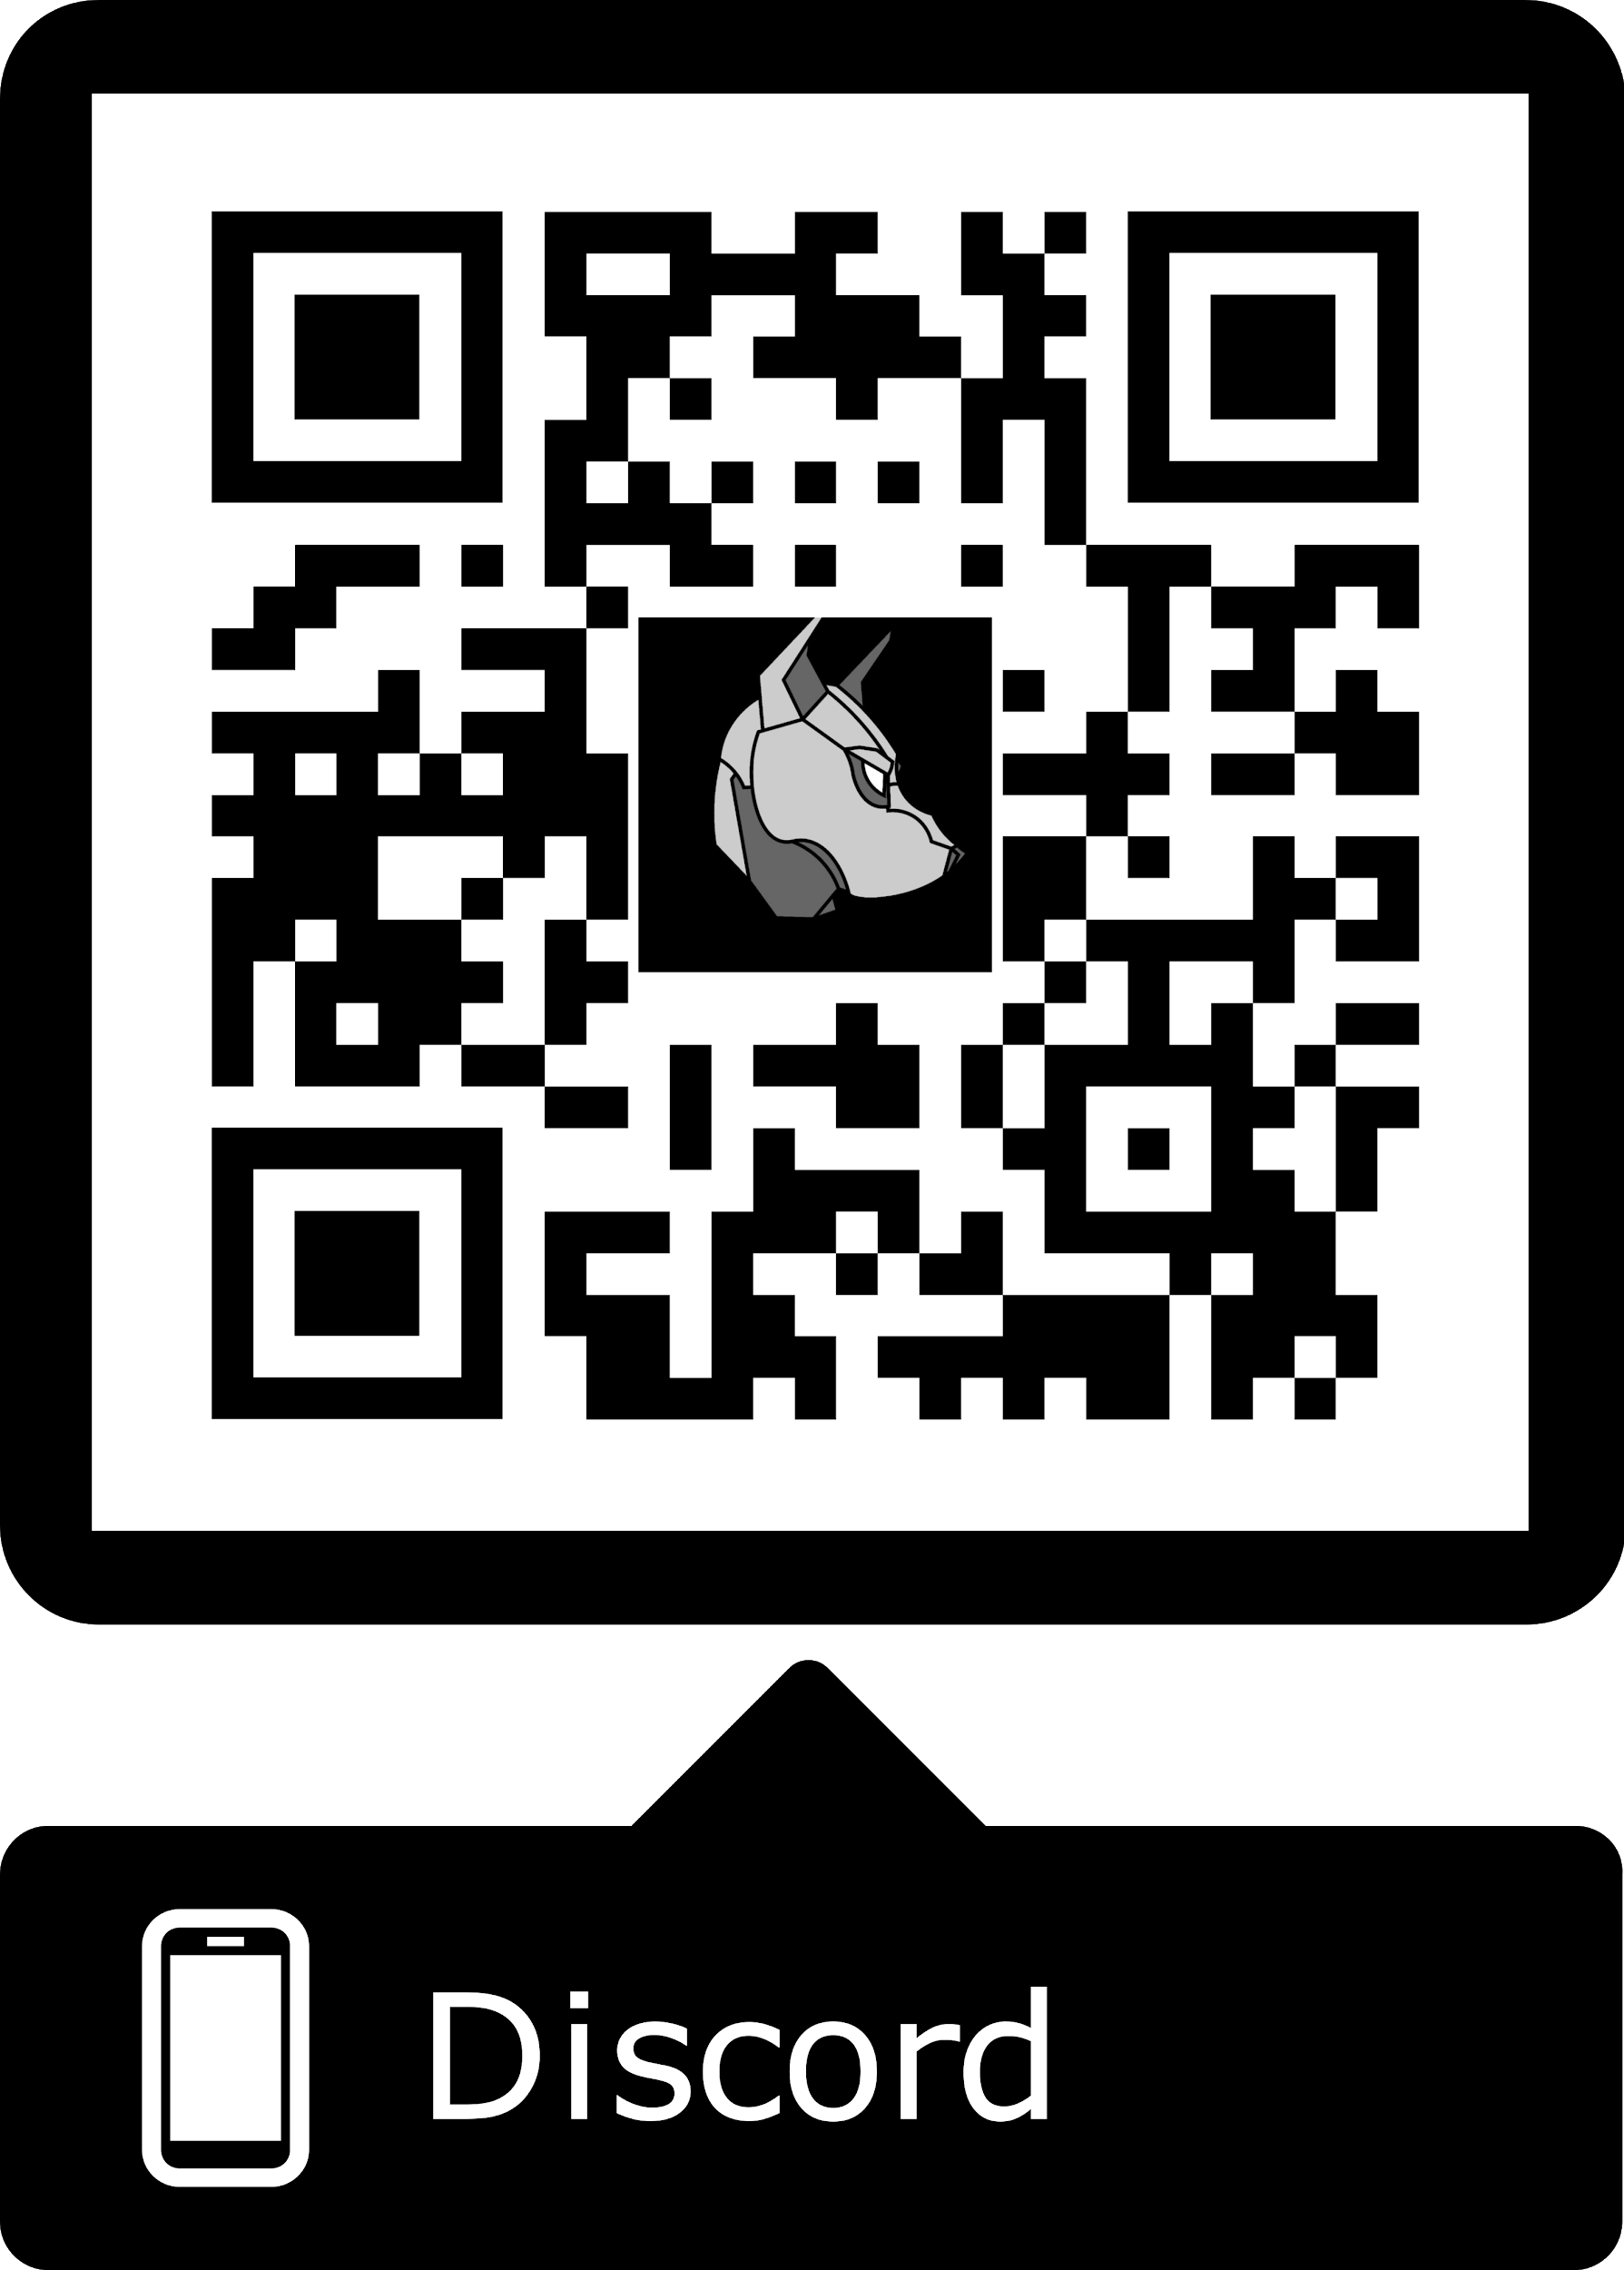
Cya Next week!
PC Assembly Workshop- February 19th(?)
If you have any good memes send them to the email below.
wcsmith@albany.edu
Follow us on Twitter? Add on myInvolvement?
CCDC! - Mondays 7:30-9:00pm
BB123 (Check email).
https://discord.gg/9Dh6R5R

